Slide 1
National Training of Trainers for COVID-19
March 7, 2020
Dr. Sidhartha Giri
Scientist E
Indian Council of Medical Research

Slide 2
Samples to be collected for COVID-19 testing
Essential samples:
- Throat swab (oropharyngeal swab).
- Nasal swab (Nasopharyngeal swab)
Other preferred samples:
- Bronchoalveolar lavage
- Tracheal aspirate Wide mouth sterile plastic containers
- Sputum
In lab confirmed patients:
- Blood
- Stool and urine - Wide mouth sterile plastic containers

Slide 3
Personal protective equipment
WHO interim guidance document for Rational use of personal protective equipment for coronavirus disease 2019 (COVID-19)

Slide 4
Collection of OP and NP swabs
Optimal timing:
Within 3 days of symptom onset and no later than 7 days.
Preferably prior to initiation of antimicrobial chemoprophylaxis or therapy.

Slide 5
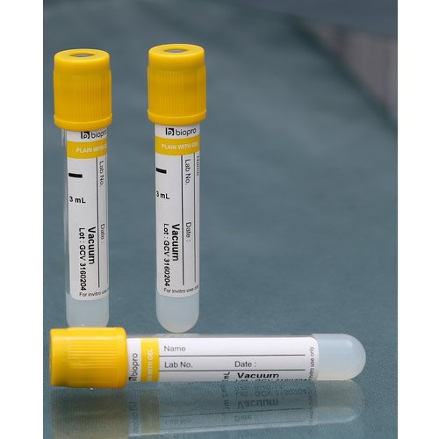
Blood collection from positive cases
Blood sample collection from all positive cases
Plasma sample collection in EDTA vials
Resin separator tubes for serum sample collection

Slide 6
Guidance for specimen Collection
A BSL2 containment level is required to handle suspected samples.
Consider all specimens as POTENTIALLY HAZARDOUS / INFECTIOUS.
Handle all specimens with gloves in a secure manner.
Place each specimen into a separate container labeled with the patient's name and identification number, the collection site, the date of collection and the time of the collection.
Do not contaminate the outside of the specimen container.
Do not handle laboratory requisition forms with gloves.

Slide 7
Storage of Specimen
Keep refrigerated (2-8 °C) if it is to be processed (or sent to a reference laboratory) within 48 hours.
Keep frozen (-10 to -20 °C) if it is to be processed after the first 48 hours or within 7 days.
Keep frozen (-70 °C) if it is to be processed after a week. The sample can be preserved for extended periods.

Slide 8
Guidelines followed for sample packaging & transport
WHO Guidelines for Transport of Infectious Substances:
- Guidance on regulations for the Transport of Infectious Substances 2009–2010.
https://www.who.int/csr/resources/publications/biosafety/WHO_HSE_EPR_2008_10.pdf
IATA guidelines

Slide 9
Classification of Infectious Substances
Category A: An infectious substance which is transported in a form that, when exposure to it occurs, is capable of causing permanent disability, life-threatening or fatal disease in otherwise healthy humans or animals.
- UN 2814 for Infectious substances which cause disease in humans or both in humans and animals.
- UN 2900 for Infectious substances which cause disease only in animals

Slide 10
Classification of Infectious Substances
Category B: An infectious substance which does not meet the criteria for inclusion in Category A.
- Infectious substances in Category B shall be assigned to UN 3373
SARS-CoV-2 virus infectious/potentially infectious material falls under category B

Slide 11
Packaging System
The original samples should be packed, labeled and marked, and documented as Category B.
Standard triple packing for Category B to be followed.
Samples to be sent on dry ice (if possible). However using cold packs is acceptable.
Sender should provide prior intimation about shipment of samples to the nearest certified laboratory.

Slide 12
Triple packaging system
Primary Container | Secondary Container | Outer Container/ Packaging Box
Watertight and leak proof Cap correctly and securely closed. Keep in upright position during transport | Watertight Several clinical specimens may be placed into one secondary container Containers have to be cleansed and disinfected if they are to be re-used E.g.: Disposable, zip-lock plastic bags; Large centrifuge tubes (50 ml) with screw caps | Made of strong material that can be cleansed and disinfected Should have the Biohazard warning label A content list in a sealed plastic bag inside the transport box may also be included

Slide 13
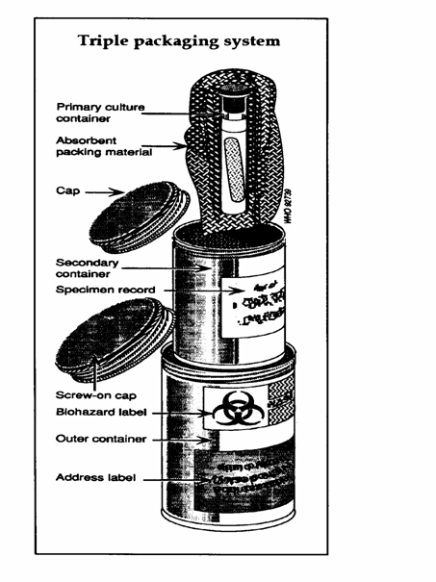
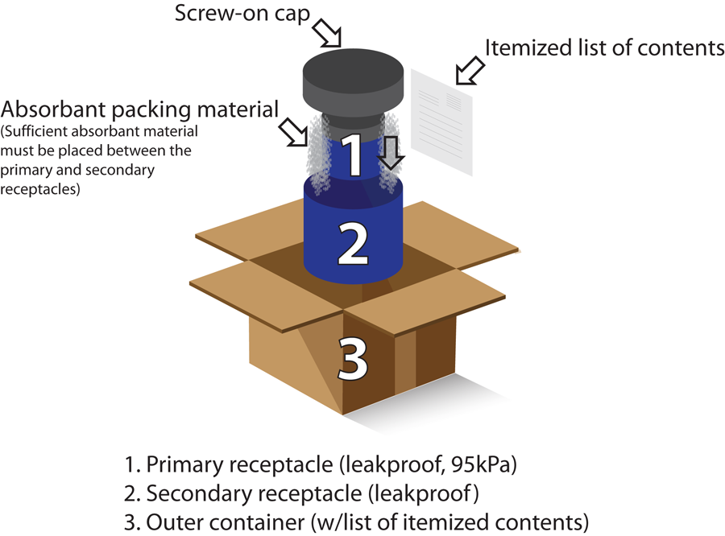

Slide 14
Transport Precautions
Adequate cushioning materials inside the box to absorb shocks during transport
Adequate absorbing material to absorb any spillage should it occur
Do not stick the request form on the specimen
Specimen request forms should be put into a separate plastic bag
The outer container, secondary containers and specimen racks for transport should be thoroughly cleansed and disinfected periodically (i.e. at least daily) and when contaminated.

Slide 15
Labeling of Package
Sender’s, name, address and telephone number
Whom to contact in case of emergency with telephone number
Receiver’s name, address and telephone number
Proper shipping name (e.g. “BIOLOGICAL SUBSTANCE, CATEGORY B”)
UN number e.g. 3373
Temperature storage requirements
Quantity of dry ice inside the container
Arrow mark to indicate upright direction

Slide 16
Responsibility of Sender
Make advance arrangements with the carrier
-that the shipment will be accepted for appropriate transport
- that the shipment (direct transport if possible) is undertaken by the most direct routing
Prepare necessary documentation, including permits, dispatch and shipping documents
Notify the receiver in advance of transportation arrangements and expected date of delivery of shipment

Slide 17
Responsibility of Receiver
Acknowledge receipt of specimen
Verify the integrity of packaging
Box to be opened by personnel wearing adequate PPE.
Open within Biosafety cabinet
Check the specimens with the data sent
Apply acceptance and rejection criteria

Slide 18
Types of Tests
No validated serological tests
Only molecular diagnosis
- PCR based test aims at detection of the virus.
Real time PCR platform is required.

Slide 19
51 VRDLs doing SARS-CoV-2 testing
56 VRDLs as collection sites

Slide 20
Tests for SARS-CoV-2
No validated serological tests are available.
Only molecular tests available.
Laboratory protocols designed on the basis of WHO guidance and sequences available in GISAID.
First line screening assay: E gene.
Confirmatory assays: RdRp and ORF 1b.
SoPs and testing protocol shared with all testing laboratories.

Slide 21
https://icmr.nic.in/node/39071

Slide 23
Thank You

