Slide 1

Infection Prevention & Control
Dr Mala Chhabra
Consultant, Microbiology
ABVIMS & Dr RMLH
New Delhi
malachhabra@yahoo.co.in
COVID 19 TOT March 2020

Slide 2
What is infection prevention and control?
Infection prevention and control is:
a scientific approach with
practical solutions designed to prevent harm, caused by infections, to patients and health care workers
grounded in principles of infectious disease, epidemiology, social science and health system strengthening, and
rooted in patient safety and health service quality
Source: WHO Infection Prevention and control web pages;; https://www.who.int/gpsc/ipc/en/
Notes:
Infection prevention and control (IPC) is a scientific approach and practical solution designed to prevent harm caused by infection to patients and health workers. It is grounded in infectious diseases, epidemiology, social science and health system strengthening. IPC occupies a unique position in the field of patient safety and quality universal health coverage since it is relevant to health workers and patients at every single health-care encounter.

Slide 3







Who is at risk of infection?
Everyone
Notes:
Who is at risk of infection?
( Give participants about 10-15 seconds then click and the word everyone will appear)

Slide 4
Benefits of IPC
Protecting yourself
Protecting your family, community & environment
Protecting your patients
WHO2015 Safe & Quality Health Services Package
Notes:
Source: WHO2015 Liberia Safe & Quality Health Services Package
Proper adherence to standard infection prevention and control practices can help to protect you, as the health care worker, your patients and ultimately, your family and community,

Slide 5
IPC goals in outbreak preparedness​
To reduce transmission of health care associated infections​
To enhance the safety of staff, patients and visitors​
To enhance the ability of the organization/health facility to respond to an outbreak ​
To lower or reduce the risk of the hospital (health care facility) itself amplifying the outbreak​

Slide 6
Role of the IPC focal point, team or committee
Knowledge: have an understanding of the IPC strategies needed for outbreaks/epidemics, etc
Assessment, preparedness and readiness
Policy and SOPs development
Participate in response and recovery
Participate in surveillance & monitoring
Patient management
Infrastructure for patient management
Education
Notes:
We won’t have enough time for this part of the session but what do you think is the role of the IPC Focal Point, the IPC Team or Committee in Outbreak Preparedness. Please write just one on a post-it.
These next few slides should help to add some clarity to the role of The IPC focal point/team/committee in outbreak preparedness.
As the IPC focal point, your first responsibility is your knowledge. You need to have a good understanding of IPC and the strategies needed to reduce risks and be prepared for outbreak situations. This is acquired through face-to-face or online courses participated during your academic study, training/s you have participated, readings, experience, research and networking. IPC requires continuous learning.

Slide 7
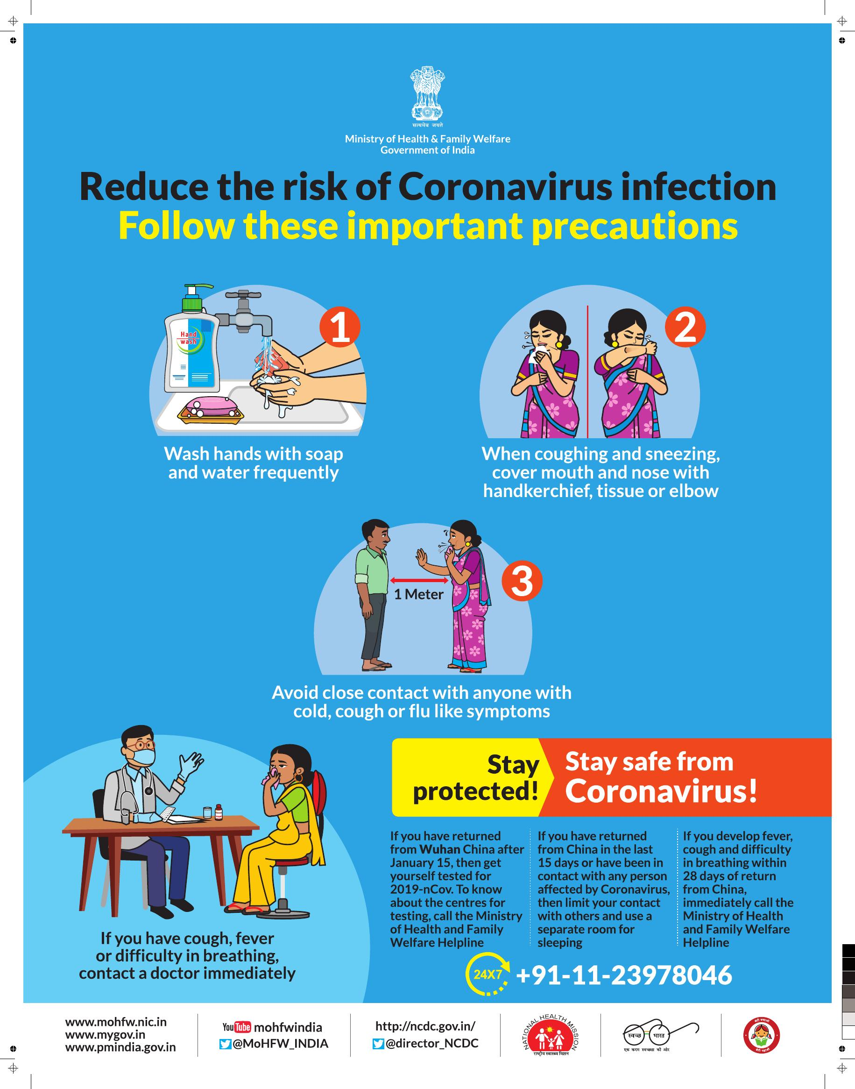
General advice for
COVID-19
Avoid close contact with people suffering from acute respiratory infections
Frequent hand hygiene, especially after direct contact with ill people or their environment
People with symptoms of acute respiratory infection should practice
  respiratory etiquette
  wear a medical mask
  seek medical care for advice

Slide 8

IPC strategies

Slide 9
IPC strategies for preventing/limiting the spread of COVID-19
  Applying standard precautions for all patients
  Ensuring triage, early recognition, and source control
  Implementing empiric additional precautions for suspected cases of COVID-19 infection
  Implementing administrative controls
  Using environmental and engineering controls.

Slide 10
Standard Precautions

Slide 11
Standard precautions
The basic level of IPC precautions, to be used for ALL patients at ALL times regardless of suspected or confirmed status of the patient
Risk assessment is critical for all activities, i.e. assess each health care activity and determine the personal protective equipment (PPE) that is needed for adequate protection
Notes:
Standard precautions are the cornerstone for prevention in all health care settings. They are a set of precautions aiming to protect both HCW and patients from infectious agents. Standard precautions are recommended for care of all patients regardless of their suspected or confirmed diagnosis in any health care setting.
Transmission-based precautions are additional precautions used for patients that are suspected or confirmed to be infected or colonized with certain pathogens for which the mode of transmission is known. They are used in addition to Standard Precautions.
Transmission-based Precautions include:
Contact
Droplet
Airborne
The type of precaution assigned to a patient will depend on the mode of transmission of the suspected or confirmed pathogen. This will be discussed n a later module.
Risk assessment is a concept that every health care worker should be able to do; identifying sources of infection or actions that can lead to infections both for themselves or their patients. It relies on an understanding of “why” IPC is implemented, and not just memorization of “what.”.
All r health care workers should constantly assess risk related to their activities.

Slide 12
Elements of Standard Precautions
  Hand hygiene
  Respiratory hygiene (etiquette)
  PPE according to the risk
  Safe injection practices, sharps management and injury prevention
  Safe handling, cleaning and disinfection of patient care equipment
  Environmental cleaning
  Safe handling and cleaning of soiled linen
  Waste management
Notes:
There are several core elements to Standard precautions. These include
1. Clean your hands
2. Practice respiratory hygiene-cougher your coughs and sneezes
3. Wear protective equipment-according to your risk assessment
4.Handle sharps carefully, use aseptic technique to deliver injections
5.Properly clean and disinfect/sterilize patient care equipment
6. Maintain a clean and disinfected environment
7. Safe handling and cleaning of soiled linen
8. Properly dispose of waste
We will go through all of these in more detail later.

Slide 13
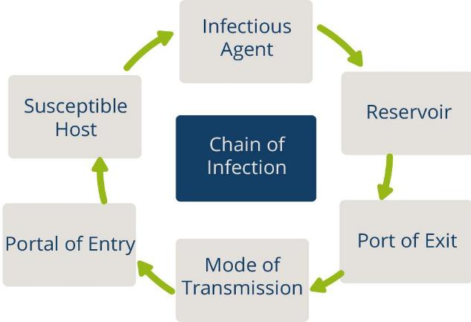
Chain of Transmission
For an infection to spread, all links must be connected
Breaking any one link, will stop disease transmission!
Notes:
An infection occurs when a microorganism enters the body, increases in number, and damages tissues in the body. The diagram represents the chain of infection. For any infection to spread, all steps in the chain must occur. The key to stopping the spread of infection is to break at least one link within the chain.

Slide 14
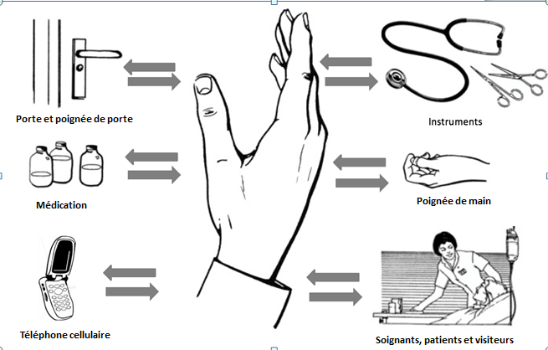
Hand Hygiene
Best way to prevent the spread of germs in the health care setting and community
Our hands are our main tool for work as health care workers- and they are the key link in the chain of transmission
Door handles
Instruments
Medication
Cellphones
Caregivers
Notes:
Why is hand hygiene important? Studies have shown that the best way to prevent the spread of germs (micro-organisms) in health care settings and in your community is through good hand hygiene practices.
Up to 30% of health care infections are preventable, many through proper hand hygiene.
Good hand hygiene protects you, your patients and your co- workers

Slide 15
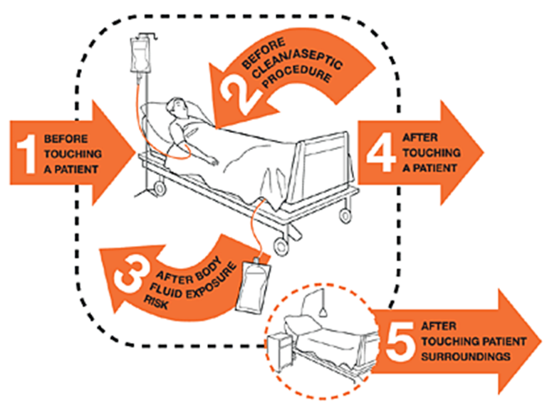
Hand hygiene: WHO 5 moments
https://www.who.int/infection-prevention/tools/hand-hygiene/en/
Notes:
Source: Hand hygiene link: https://www.who.int/infection-prevention/tools/hand-hygiene/en/

Slide 16
Hand hygiene: HOW
Use appropriate product and technique
An alcohol-based hand rub product is preferable, if hands are not visibly soiled
  Rub hands for 20–30 seconds!
Soap, running water and single use towel, when visibly dirty or contaminated with proteinaceous material
  Wash hands for 40–60 seconds!
https://www.who.int/infection-prevention/tools/hand-hygiene/en/
Notes:
Source: Hand hygiene link: https://www.who.int/infection-prevention/tools/hand-hygiene/en/

Slide 17
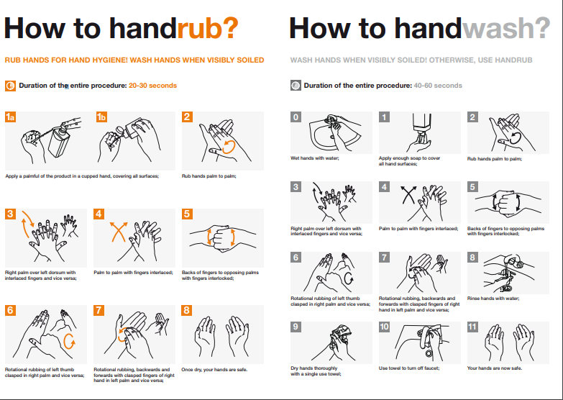
https://www.who.int/infection-prevention/tools/hand-hygiene/en/
Notes:
Source: Hand hygiene link: https://www.who.int/infection-prevention/tools/hand-hygiene/en/

Slide 18


Respiratory hygiene/etiquette
Reduces the spread of microorganisms (germs) that cause respiratory infections (colds, flu).
Turn head away from others when coughing/sneezing
Cover the nose and mouth with a tissue.
If tissues are used, discard immediately into the trash
Cough/sneeze into your sleeve if no tissue is available
Clean your hands with soap and water or alcohol based products
Do not spit here and there
Image source: https://www.who.int/emergencies/diseases/novel-coronavirus-2019/advice-for-public
Notes:
Some basic measures we can all do ourselves and encourage our patients and family or community members to do are:
Turn your head away from others when coughing/sneezing
Cover your nose/mouth with a tissue-and then immediately dispose of it n the garbage/trash
If there is no tissue available, cough into your sleeve –not your hands!
Always clean your hands with soap and water or alcohol hand sanitizer after coughing, sneezing or blowing your nose.

Slide 19

Promoting respiratory hygiene
Encourage handwashing for patients with respiratory symptoms
Provide masks for patients with respiratory symptoms
Patients with fever + cough or sneezing should be kept at least 1m away from other patients
Post visual aids reminding patients and visitors with respiratory symptoms to cover their cough
Notes:
There are some additional steps we can take in the health care setting to protect our patients and ourselves. These include :
Encouraging our patients to clean their hands if they re coughing/sneezing
Provide a mask for a patients who has respiratory symptoms and patients who have a fever and a cough or sneezing should be kept at least 1m or more away from other patients.
Can you think if this is possible in your health care setting( are beds >1m apart? What about in the waiting room of a hospital emergency room or a health clinic? Where do you put patients who have a fever and are coughing?
Consider having tissues and masks available for patients in patient care areas. Finally, we an post signs reminding patients to cover their coughs and wash their hands.

Slide 20
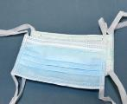
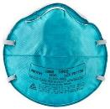
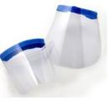
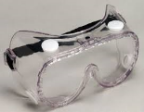
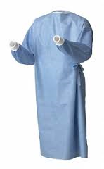

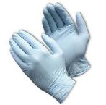
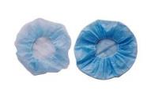
PPE for use in health care for COVID-19
Face Mask
N95 Mask
Face shield
Goggle
Nose + mouth
Nose + mouth
Eyes + nose + mouth
Eyes
Gown
Apron
Gloves
Head cover
Head + hair
Body
Hands
Body
Notes:
Source: WHO2015 Liberia Safe & Quality Health Services Package
These are some examples of the different types of PPE.
( review the slide)
*NOTE-this is an opportunity to highlight the products available in your facility- If you have some samples bring them with you

Slide 21
Risk Assessment and Standard Precautions
Risk assessment: risk of exposure and extent of contact anticipated with blood, body fluids, respiratory droplets, and/or open skin
    Select which PPE items to wear based on this assessment
    Perform hand hygiene according to the WHO “5 Moments”
    Should be done for each patient, each time
  Make this routine!
Notes:
In health care risk assessment is also an evaluation of the interaction that is about to take place between the health care worker, the patient and the patient environment to assess and analyze the potential for exposure to to blood, body fluids ,respiratory droplets and /or open skin.
The health care worker should perform a risk assessment for each interaction with a patient and select the required PPE.
This needs to be part of the patient care routine

Slide 22
Minimize direct unprotected exposure to blood and body fluids
Risk assessment for
appropriate use of PPE
EYE-WEAR | MEDICAL MASK | GOWN | GLOVES | HAND HYGIENE | SCENARIO
 |  |  |  | x | Always before and after patient contact, and after contaminated environment
 |  |  | x | x | If direct contact with blood and body fluids, secretions, excretions, mucous membranes, non-intact skin
 |  | x | x | x | If there is risk of splashes onto the health care worker’s body
x | x | x | x | x | If there is a risk of splashes onto the body and face

Slide 23
Principles for using PPE (1)
Always clean your hands before and after wearing PPE
PPE should be available where and when it is indicated
  in the correct size
  select according to risk or per transmission based precautions
Always put on before contact with the patient
Always remove immediately after completing the task and/or leaving the patient care area
NEVER reuse disposable PPE
Clean and disinfect reusable PPE between each use
Notes:
There are a few important principles that need to be followed when using PPE.
PPE should be available where an when it is needed. If you have to go to anther place to get your PPE ,chances are you won wear it when needed. So it is very important that management and supervisors ensure PPE is always available.
If you cant find the PPE you need, you need to inform your supervisor or manager.
PPE should fit –it needs to be the correct size in order to provide adequate protection. For example, gloves that are too small may tear, gloves that are too big may allow body fluids to get inside or make tasks difficult to perform.
Always perform a risk assessment before selecting your PPE. WE will talk more about this.
Always put on PPE before contact with the patient or the task you are going to do and remove it immediately after you are finished.
Remove PPE as soon as you are finished the care or task and before leaving the patient area.( do not walk to another area or patient bed in your PPE! )
Disposable PPE must never be reused. Reusable PPE must be cleaned and disinfected between each use

Slide 24
Principles for using PPE (2)
Change PPE immediately if it becomes contaminated or damaged
PPE should not be adjusted or touched during patient care; specifically
  never touch your face while wearing PPE
  if there is concern and/or breach of these practices, leave the patient care area when safe to do so and properly remove and change the PPE
  Always remove carefully to avoid self-contamination (from dirtiest to cleanest areas)
Notes:
A few more points to remember. Always remove PPE carefully so you don’t contaminate yourself. WE will practice this later.
If you PPE becomes damaged or contaminated , stop what you are doing and change it immediately
If the PPE is disposable- never reuse it. Discard it appropriately.

Slide 25
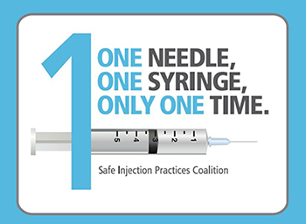
The seven steps to safe injections
1 Clean work space
2 Hand hygiene
3 Sterile safety-engineered syringe
4 Sterile vial of medication and diluent
5 Skin cleaning and antisepsis
6 Appropriate collection of sharps
7 Appropriate waste management
https://www.who.int/infection-prevention/tools/injections/training-education/en/
Notes:
There are 7 steps to giving a safe injection. It is important that anyone giving injections follow these steps, to protect your patient and yourself

Slide 26
Environment cleaning, disinfection and BMWM
It is important to ensure that environmental cleaning and disinfection procedures are followed consistently and correctly.
Thorough cleaning environmental surfaces with water and detergent and applying commonly used hospital level disinfectants (such as sodium hypochlorite, 0.5%, or ethanol, 70%) are effective and sufficient procedures.
Medical devices and equipment, laundry, food service utensils and medical waste should be managed in accordance with safe routine procedures.

Slide 27
Triage, early recognition, and source control

Slide 28
Manage ill patients seeking care
Use clinical triage in health care facilities for early identification of patients with acute respiratory infection (ARI) to prevent the transmission of pathogens to health care workers and other patients.
Timely and effective triage and infection control
Admit patients to dedicated area
Safe transport and discharge home
Specific case and clinical management protocols

Slide 29
Triage (1)
Prevent overcrowding.
Conduct rapid triage.
Place ARI patients in dedicated waiting areas with adequate ventilation.
In addition to standard precautions, implement droplet precautions and contact precautions (if close contact with the patient or contaminated equipment or surfaces/materials).
Ask patients with respiratory symptoms to perform hand hygiene, wear a mask and perform respiratory hygiene.
Ensure at least 1 m distance between patients
Timely and effective triage and infection control
Admit patients to dedicated area
Safe transport and discharge home
Specific case and clinical management protocols

Slide 30
Triage (2)
The triage or screening area requires the following equipment:​
Screening questionnaire​
Algorithm for triage​
Documentation papers​
PPE​
Hand hygiene equipment and posters​
Infrared thermometer​
Waste bins and access to cleaning/disinfection​​
Post signage in public areas with syndromic screening questions to instruct patients to alert HCWs.

Slide 31
Triage (3)
Set up of the area during triage:
Ensure adequate space for triage​ (maintain at least 1 m distance between staff screening and patient/staff entering​)
Waiting room chairs for patients should be 1m apart​
Maintain a one way flow for patients and for staff​
Clear signage​ for symptoms and directions
Family members should wait outside the triage area-prevent triage area from overcrowding​

Slide 32
Hospital admission
Place patients with ARI of potential concern in single, well ventilated room, when possible
Cohort patients with the same diagnosis in one area
Do not place suspect patients in same area as those who are confirmed.
Assign health care worker with experience with IPC and outbreaks.
Timely and effective triage and infection control
Admit patients to dedicated area
Safe transport and discharge home
Specific case and clinical management protocols

Slide 33
Additional Precautions

Slide 34
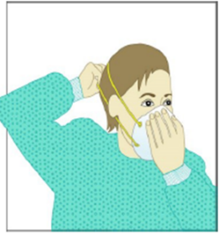
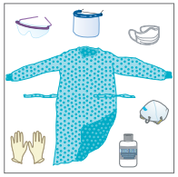

Patients suspected or confirmed COVID-19 (1)
Contact and droplet precautions for all patients with suspected or confirmed COVID-19
Airborne precautions are recommended only for aerosol generating procedures (i.e. open suctioning of respiratory tract, intubation, bronchoscopy, cardiopulmonary resuscitation).
Preferably patient should be in a single room:
    natural ventilation with air flow of at least 160 L/s per patient or
    in negative pressure rooms with at least 12 air changes per hour and controlled direction of air flow when using mechanical ventilation
Cohort: All patients with respiratory illness should be in a single room, or minimum 1m away from other patients when waiting for a room
Dedicated & trained HCW
HCW to wear PPE: a medical mask, goggles or face shield, gown, and gloves
Hand hygiene should be done any time the WHO “5 Moments” apply, and before PPE and after removing PPE

Slide 35

Patients suspected or confirmed COVID-19 (2)
Equipment should be single use when possible, dedicated to the patient and disinfected between uses
Avoid transporting suspected or confirmed cases – if necessary, have patients wear masks. HCW should wear appropriate PPE.
Routine cleaning of the environment is crucial
Limit the number of HCW, visitors, and family members who are in contact with the patient. If necessary, everyone must wear PPE.
All persons entering the patients room (including visitors) should be recorded (for contact tracing purposes).
Precautions should continue until the patient is asymptomatic.
Notes:
There are some additional steps we can take in the health care setting to protect our patients and ourselves. These include :
Encouraging our patients to clean their hands if they re coughing/sneezing
Provide a mask for a patients who has respiratory symptoms and patients who have a fever and a cough or sneezing should be kept at least 1m or more away from other patients.
Can you think if this is possible in your health care setting( are beds >1m apart? What about in the waiting room of a hospital emergency room or a health clinic? Where do you put patients who have a fever and are coughing?
Consider having tissues and masks available for patients in patient care areas. Finally, we an post signs reminding patients to cover their coughs and wash their hands.

Slide 36



Outpatient Care
The basic principles of IPC and standard precautions should be applied in all health care facilities, including outpatient care and primary care.
  Triage and early recognition
  emphasis on hand hygiene, respiratory hygiene and medical masks to be used by patients with respiratory symptoms (consider having signage);
  if possible – place patients in separate rooms or away from other patients in the waiting rooms, and wear mask, gloves and gown if possible when seeing them in the clinic (as much of contact and droplet precautions as possible);
  when symptomatic patients are required to wait, ensure they have a separate waiting area (1m separation);
  prioritization of care of symptomatic patients;
  educate patients and families about the early recognition of symptoms, basic precautions to be used and which health care facility they should refer to.
Notes:
Source: Public Health Measures for Scaling up National Preparedness Middle East Respiratory Syndrome (MERS)
http://applications.emro.who.int/docs/EMROPub_2018_EN_16794.pdf?ua=1&ua=1

Slide 37
Additional Control Measures

Slide 38
Notes:
Source: https://www.cdc.gov/niosh/topics/hierarchy/default.html

Slide 39
Administrative Controls
Provision of adequate training for HCWs;
Ensuring an adequate patient-to-staff ratio;
Establishing a surveillance process for acute respiratory infections potentially caused by COVID-19 among HCWs;
Ensuring that HCWs and the public understand the importance of promptly seeking medical care;
Monitoring HCW compliance with standard precautions and providing mechanisms for improvement as needed.

Slide 40
Home care for patients with suspected COVID-19 infection with mild symptoms
Place the patient in a well-ventilated single room (i.e., with open windows and an open door).
Limit the movement of the patient & minimize shared space
Household members should stay in a different room or, if that is not possible, maintain a distance of at least 1 m from the ill person (e.g., sleep in a separate bed).
Limit the number of caregivers - good health and has no underlying disease
Visitors should not be allowed.
Perform hand hygiene after contact with patients or their immediate environment, before and after preparing food, before eating, after using the toilet and whenever hands look dirty.
To contain respiratory secretions, provide medical mask to the patient.
Notes:
patients with mild symptoms1 and without underlying chronic conditions − such as lung or heart disease, renal failure or immunocompromising conditions that place the patient at increased risk of developing complications − may be cared for at home Patients and household members should be educated about personal hygiene, basic IPC measures and how to care for the member of the family suspected of having COVID-19 disease as safely as possible to prevent the infection from spreading to household contacts. The patient and the family should be provided with ongoing support and education, and monitoring shouldPatients and household members should be educated about personal hygiene, basic IPC measures and how to care for the member of the family suspected of having COVID-19 disease as safely as possible to prevent the infection from spreading to household contacts. The patient and the family should be provided with ongoing support and education, and monitoring should continue for the duration of home care. continue for the duration of home care.

Slide 41
Home care for patients with suspected COVID-19 infection with mild symptoms
Individuals who cannot tolerate a medical mask should use rigorous respiratory hygiene
Caregivers should wear a tightly fitted medical mask that covers their mouth and nose when in the same room as the patient
Avoid direct contact with body fluids. Use disposable gloves and a mask when providing oral or respiratory care and when handling stool, urine and other waste. Perform hand hygiene before and after removing gloves and the mask.
Use dedicated linen and eating utensils for the patient; these items should be cleaned with soap and water after use and may be re-used instead of being discarded.
Clean and disinfect daily surfaces that are frequently touched in the room where the patient is being cared for (Household soap or detergent should be used first for cleaning, and then, after rinsing, regular household disinfectant-sodium hypochlorite)
Clean the patient’s clothes, bed linen, and bath and hand towels using regular laundry soap and water or machine wash at 60–90 °C with common household detergent, and dry thoroughly
Notes:
patients with mild symptoms1 and without underlying chronic conditions − such as lung or heart disease, renal failure or immunocompromising conditions that place the patient at increased risk of developing complications − may be cared for at home Patients and household members should be educated about personal hygiene, basic IPC measures and how to care for the member of the family suspected of having COVID-19 disease as safely as possible to prevent the infection from spreading to household contacts. The patient and the family should be provided with ongoing support and education, and monitoring shouldPatients and household members should be educated about personal hygiene, basic IPC measures and how to care for the member of the family suspected of having COVID-19 disease as safely as possible to prevent the infection from spreading to household contacts. The patient and the family should be provided with ongoing support and education, and monitoring should continue for the duration of home care. continue for the duration of home care.

Slide 42
Use of masks
Use of Mask- limit spread of certain respiratory diseases
Mask alone is insufficient to provide the adequate level of protection and other equally relevant measures should be adopted – Hand hygiene
Wearing medical masks when not indicated may cause
  unnecessary cost
  procurement burden
  create a false sense of security that can lead to neglecting other essential measures such as hand hygiene practices.
Using a mask incorrectly may hamper its effectiveness to reduce the risk of transmission.
file:///C:/Users/Mala%20Chhabra/Downloads/WHO-nCov-IPC_Masks-2020.1-eng.pdf

Slide 43
Use of Mask : Community setting
Individuals without respiratory symptoms
  Avoid closed crowded spaces
  Maintain distance – 1m
  Practice hand and respiratory hygiene
  Refrain from touching face, nose, mouth
  No need of mask
Individuals with respiratory symptoms
  Wear a medical mask
  Seek medical care
  Learn mask management

Slide 44
Use of Mask : Home care
Individuals with suspected infection with mild respiratory symptoms
Relatives or caregivers
Along with
hand hygiene
keep distance from affected individual as much as possible (at least 1 meter)
improve airflow in living space by opening windows as much as possible
Mask management

Slide 45
Use of Mask : Health Care Settings
Individuals with respiratory symptoms should:
wear a medical mask while waiting in triage or waiting areas or during transportation within the facility;
wear a medical mask when staying in cohorting areas dedicated to suspected or confirmed cases;
do not wear a medical mask when isolated in single rooms but cover mouth and nose when coughing or sneezing with disposable paper tissues.
Health care workers should:
wear a medical mask while providing care to the patient
Use a particulate respirator N95 (NIOSH certified) , FFP2 (EU standard), or equivalent, when performing aerosol generating procedures (tracheal intubation, non-invasive ventilation, tracheotomy, cardiopulmonary resuscitation, manual ventilation before intubation, and bronchoscopy.

Slide 46
Masks management
place mask carefully to cover mouth and nose and tie securely to minimise any gaps between the face and the mask
while in use, avoid touching the mask
remove the mask by using appropriate technique (i.e. do not touch the front but remove the lace from behind)
after removal or whenever you inadvertently touch a used mask, clean hands by using an alcohol-based hand rub or soap and water if visibly soiled
replace masks with a new clean, dry mask as soon as they become damp/humid
do not re-use single-use masks
discard single-use masks after each use and dispose of them immediately upon removal

Slide 47
Conclusions
IPC is key for containment
Based on key principles- Hand Hygiene, Respiratory etiquette, safe distance
Hospital Infection Prevention & control- Standard & Additional precautions
  Protect Yourself and the community
  Triage & Admissions
  PPE
    Judicious and Appropriate use
    Pay attention to donning and doffing
Home care precautions

Slide 48
Resources
WHO Coronavirus Homepage
https://www.who.int/emergencies/diseases/novel-coronavirus-2019
All coronavirus (COVID-19) technical guidance documents
https://www.who.int/emergencies/diseases/novel-coronavirus-2019/technical-guidance
IPC documents
https://www.who.int/emergencies/diseases/novel-coronavirus-2019/technical-guidance/infection-prevention-and-control
https://www.who.int/infection-prevention/publications/en/
Questions and Answers
https://www.who.int/news-room/q-a-detail/q-a-coronaviruses

Slide 49

Thank you

Slide 50
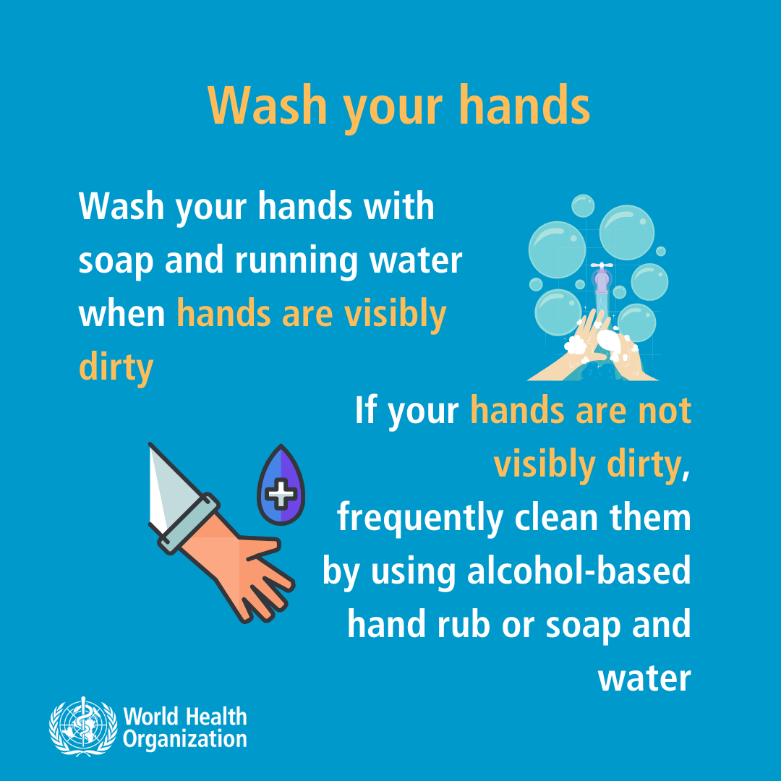

Slide 51
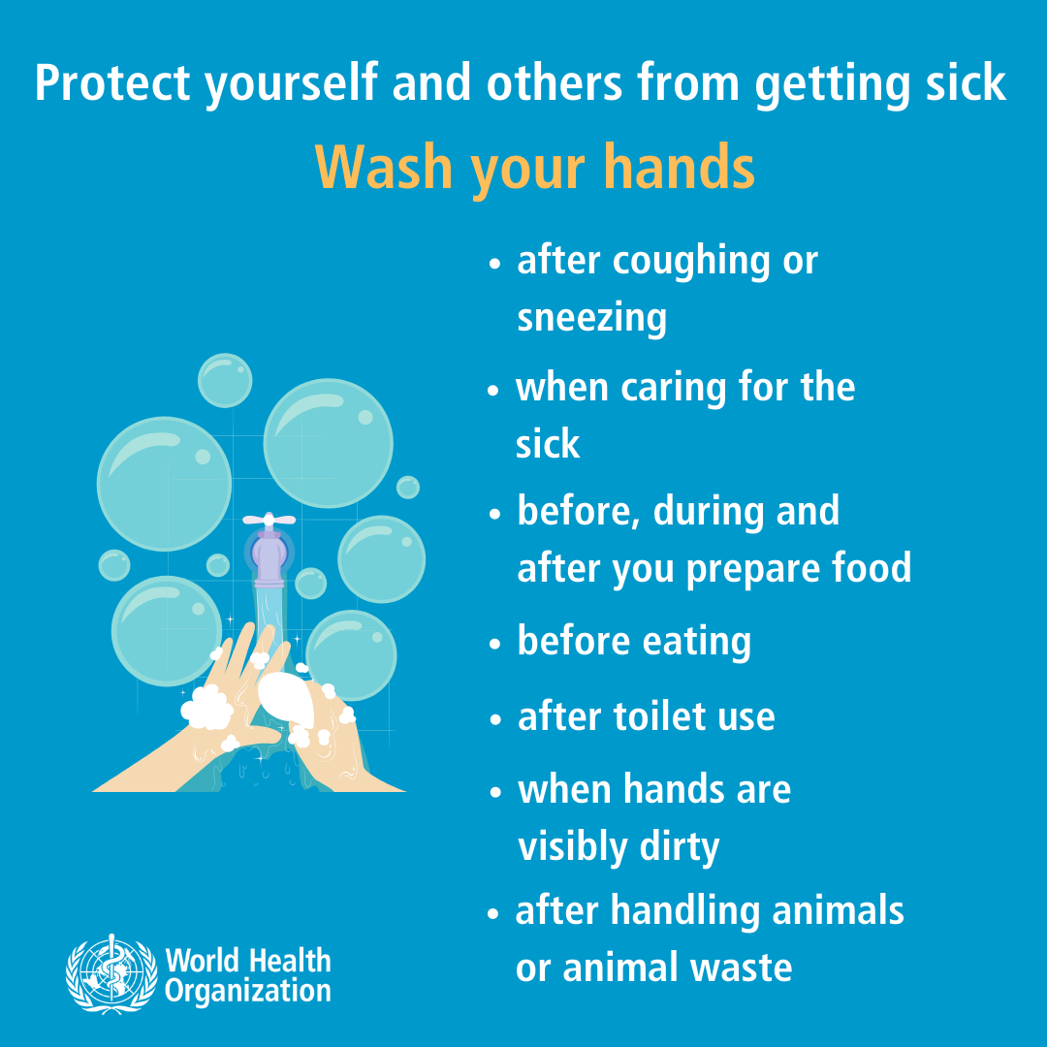

Slide 52
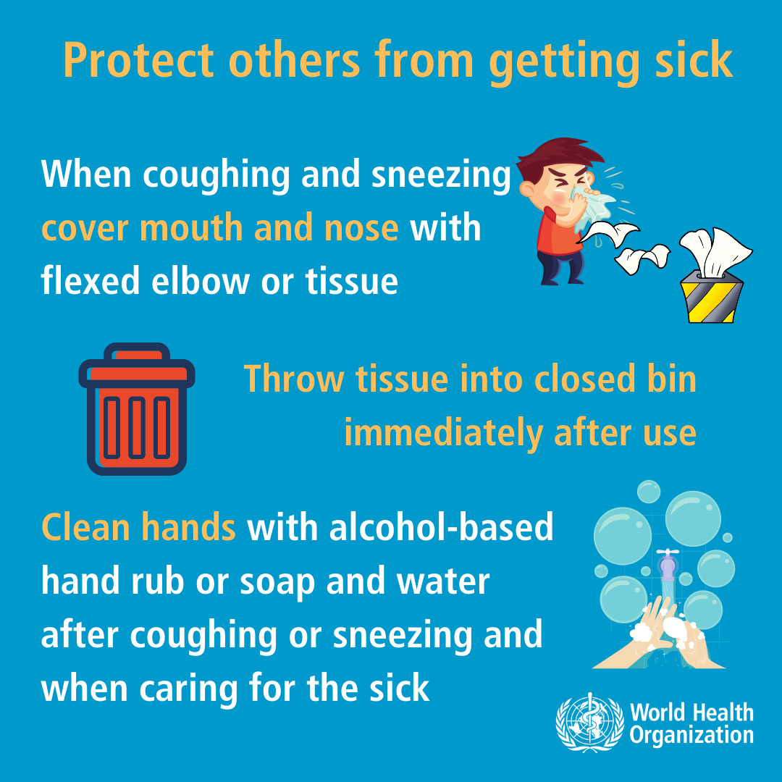

Slide 53
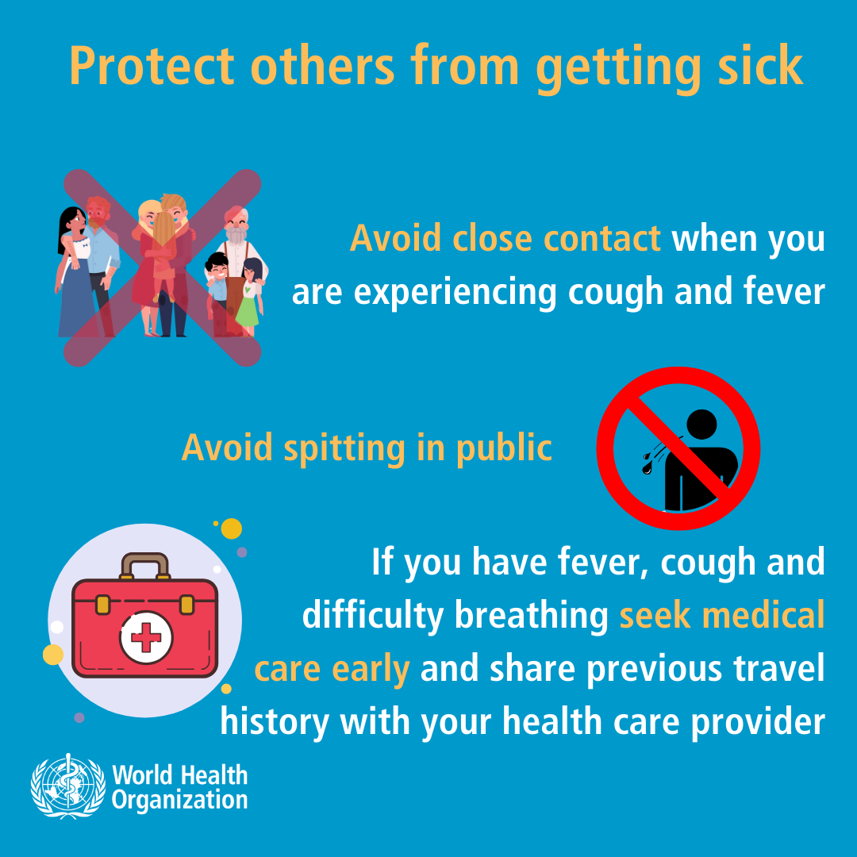

Slide 54
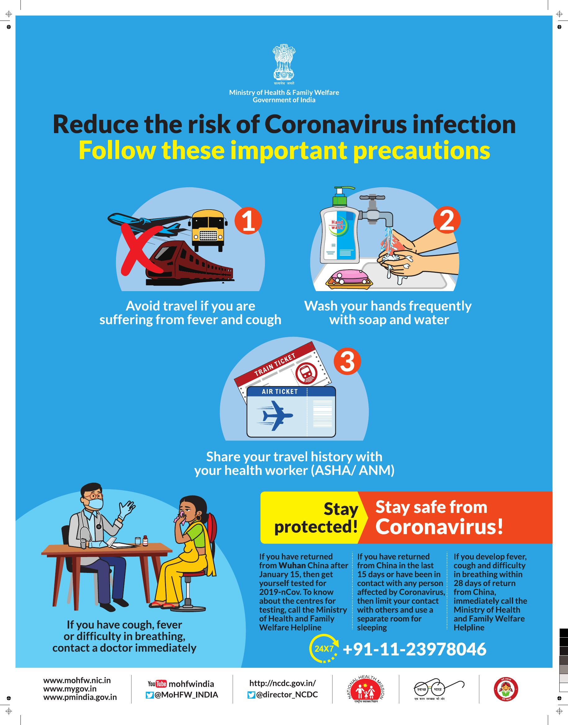

Slide 55
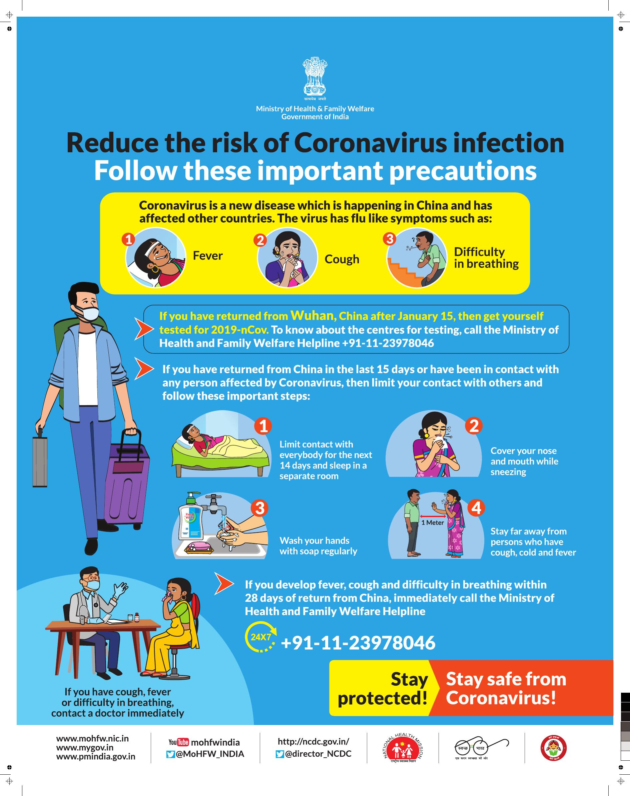

Slide 56
